Slide 1

Distinguish COVID-19 by coughing
Team 8 :
Brno Ting Ting
Members:
Victor Mutinda Mutuku
Ban SangSue
Noh HaYoung
Jang SuYoon

Slide 2
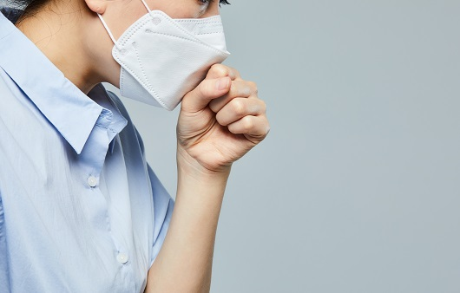


Topic : Distinguish COVID-19 by coughing
ML
COVID-19 is characterised by a dry cough and fever, among other symptoms.
Using machine learning, we can be able to identify the cough sounds to determine if a person can COVID-19 or not.

Slide 3
The Approach
Collecting data on cough sounds from people with COVID-19 and non-COVID-19 : Dacon(https://dacon.io/)
Data preprocessing : Data Labeling, Data Classification
Feature extraction : MFCC (librosa)
Making Training model : sklearn.neural_network.MLPClassifier, semi supervised
Accuracy check, Input new data and test the model

Slide 4
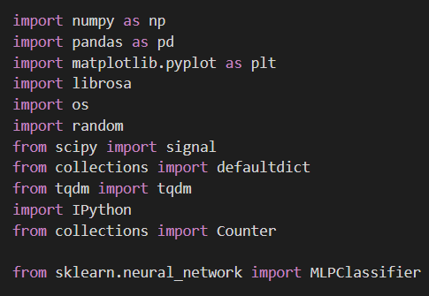
Used Libraries
sklearn, librosa, numpy, pandas, audiomentations

Slide 5
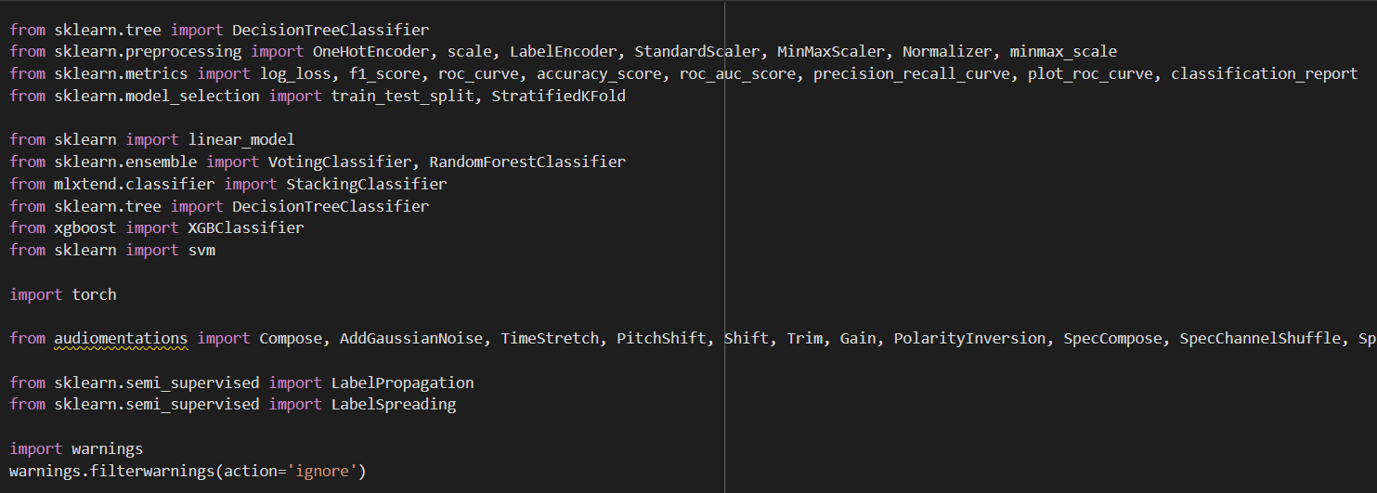
Used Libraries (continued)
sklearn, librosa, numpy, pandas, audiomentations

Slide 6

Dataset Description
The dataset was obtained from Dacon.
It contained 11,407 audio files divided as follows:
3,806 files for training
5,733 files for testing
1,868 files were unlabeled
The training and unlabeled datasets were concatenated and used to train the model.

Slide 7
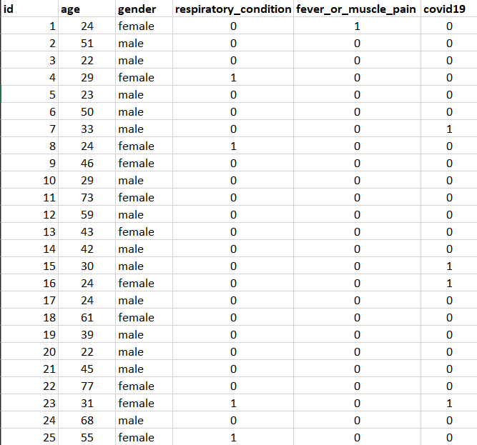
Collecting Dataset
Features used included:
Respiratory condition
Fever or muscle pain
Presence of COVID-19

Slide 8
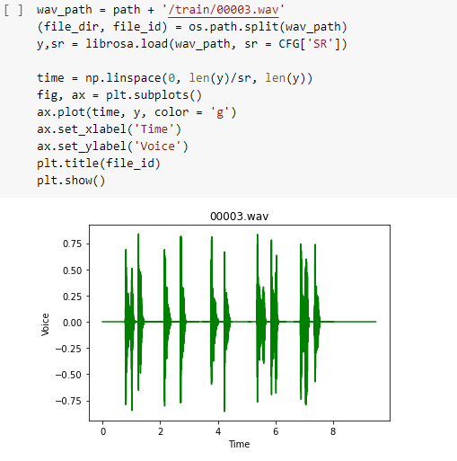
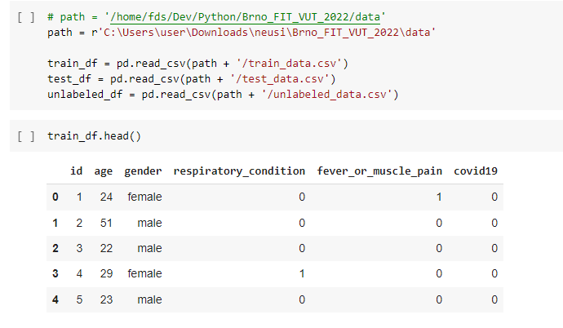
2. Data Preprocessing
Enables machine learning through data preprocessing: Data import, labeling
Used librosa, Numpy, Pandas

Slide 9
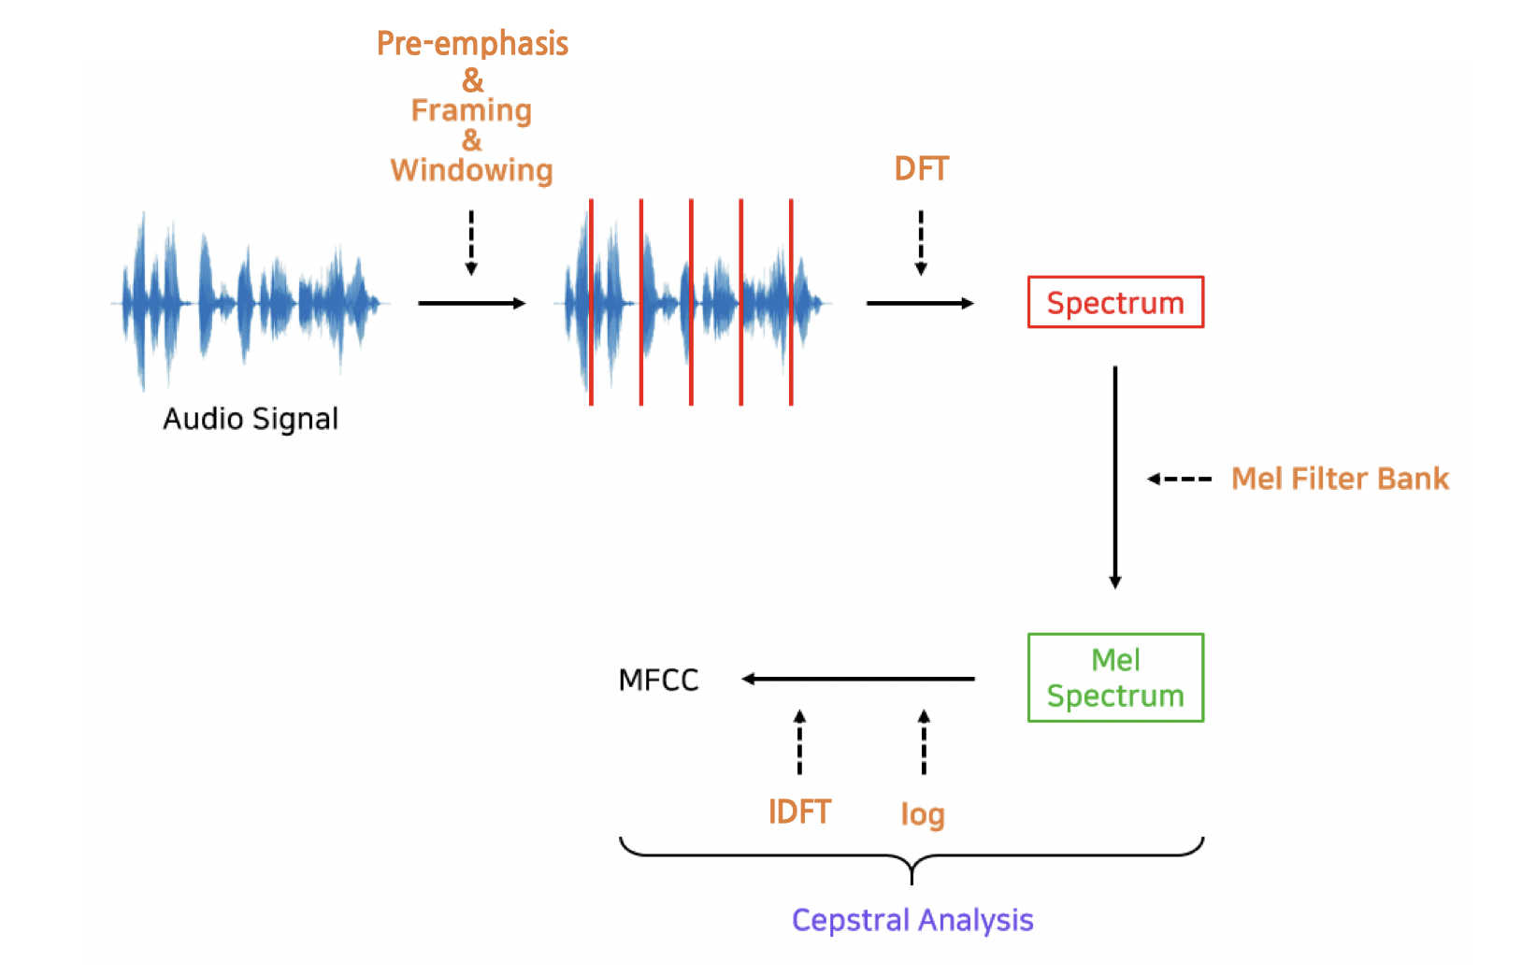
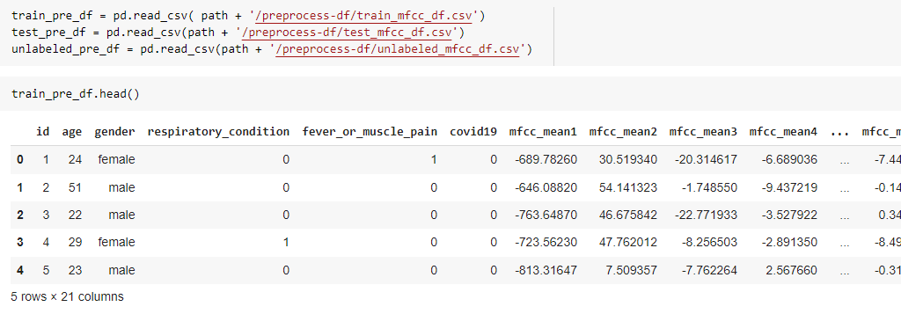
3. Feature Extraction
Extract specific values of covid-19 cough sounds through MFCC encoding
Used MFCC (librosa), sklearn preprocessing OneHotEncoder

Slide 10
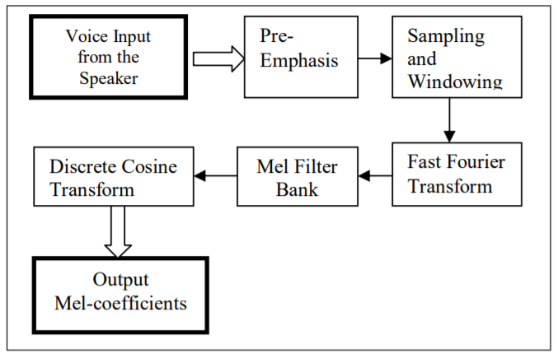
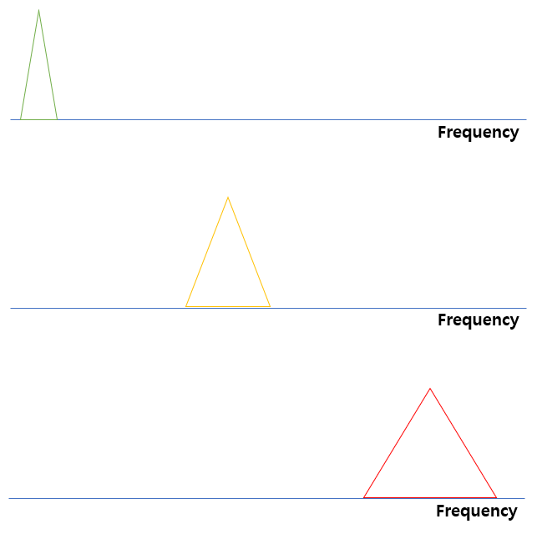
3. Feature Extraction-MFCC

Slide 11
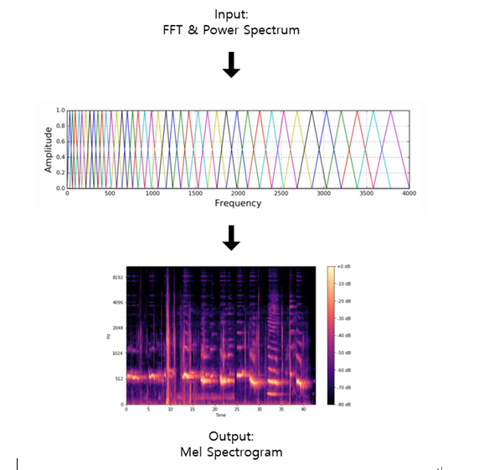
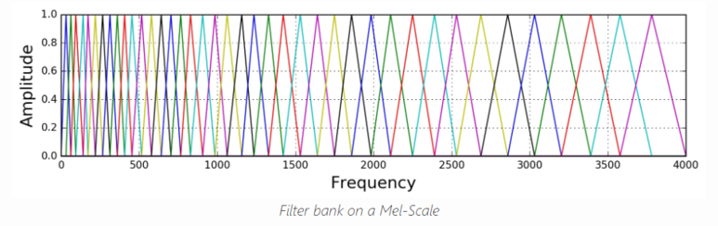
3. Feature Extraction-MFCC

Slide 12
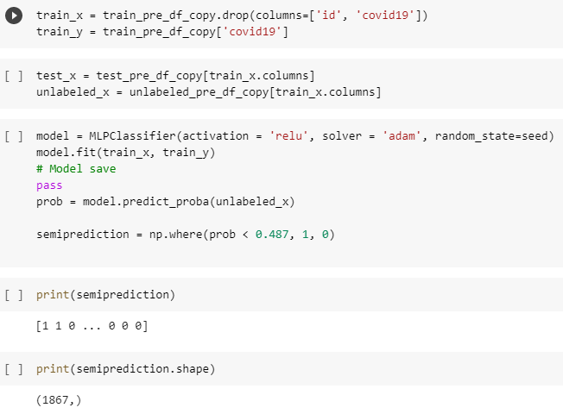
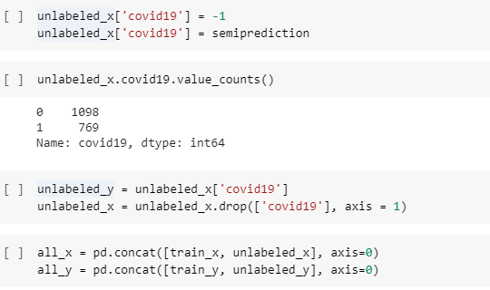
4. Making Training Model
The model was trained using Sklearn Neural Network MLPClassifier
activation = relu, solver = adam
layers = 100 (default)

Slide 13
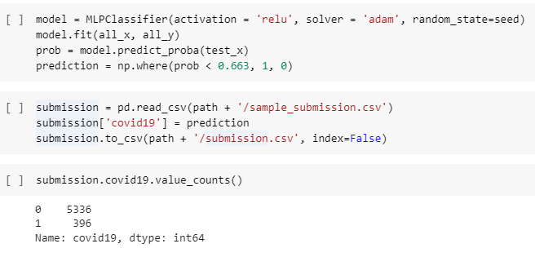
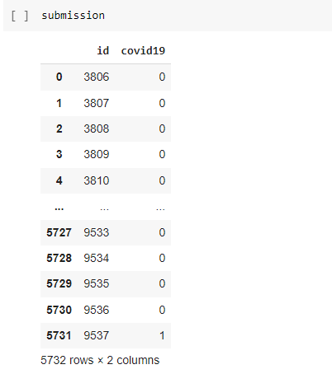
4. Making Training Model
Improve accuracy with semi-supervised learning
Determining the sound of a specific value being detected as covid-19
Results 0 is negative and 1 is positive of Covid-19

Slide 14
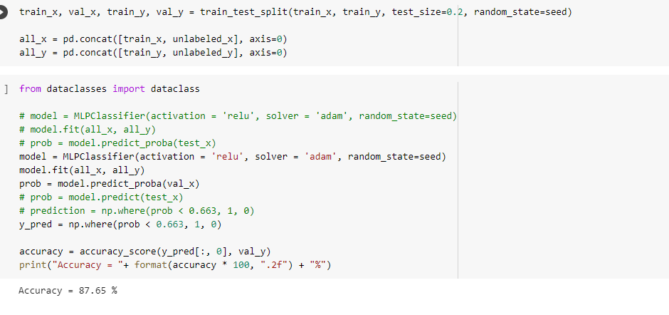
5. Accuracy measurements & model testing

Slide 15
Thank you!

